Slide 1
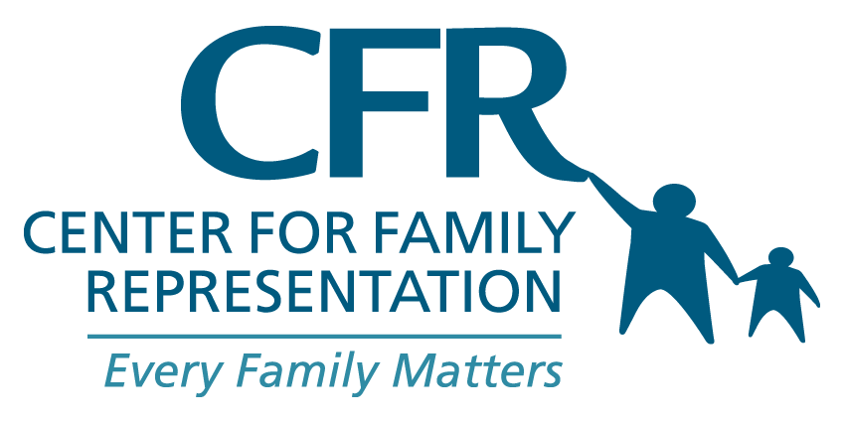
Community Education Council District 28
March 2024
Julie S. Suh, Litigation Director, Queens Practice
Ysmerlyn (Izzy) Murshed, Social Work Supervisor

Slide 2
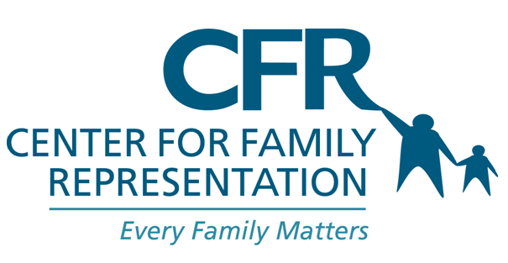
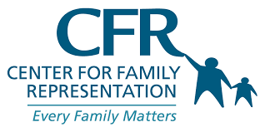
AGENDA
Who We Are
What to know about ACS
District 28 and ACS
What We Do
Contact us
.

Slide 3
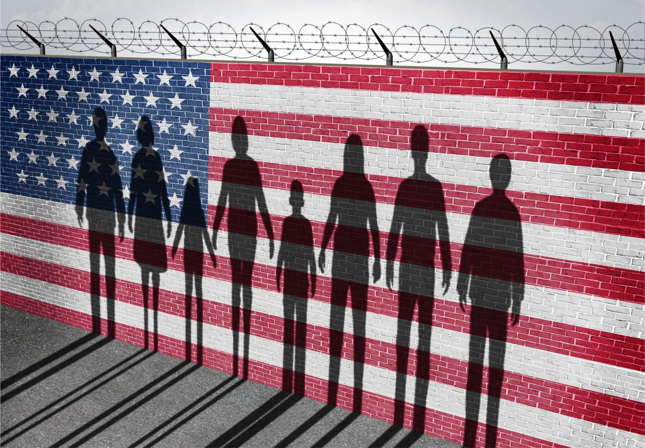
CFR: Who We Are
CFR is a holistic legal and social work advocacy organization founded in 2002
Interdisciplinary client teams and peer/parent advocate support
We serve over 2,500 families per year who are investigated or charged with neglect or abuse of a child or children
We train over 500 practitioners annually
Eligibility for our services: investigated or charged by ACS and unable to afford to hire a lawyer
Provide Know-Your-Rights trainings to youth and adults in the community
94% of the families CFR defends are charged with neglect, which is typically related to poverty, rather than abuse.

Slide 4
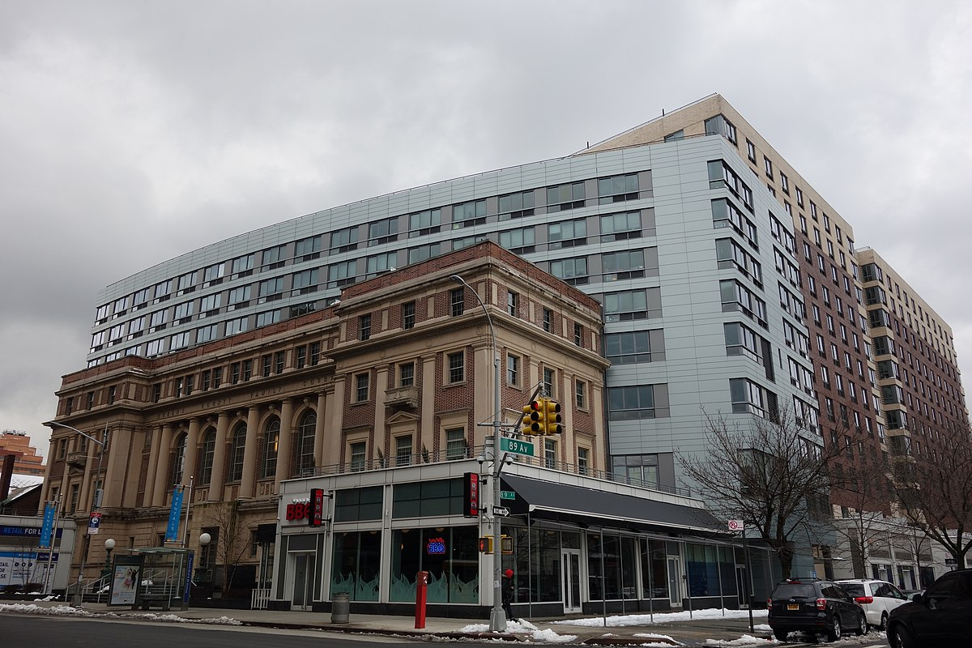
What to Know About ACS*
Investigation of Families
Removal of Children
Prosecution
Service provision–voluntary or involuntary
Any information shared with ACS is recorded and is NOT confidential
Individuals being investigated by ACS have the right to speak to a lawyer or advocate if under investigation, but ACS is not obligated to tell them
*This information does not, and is not intended to, constitute legal advice and is provided for informational purposes only.

Slide 5
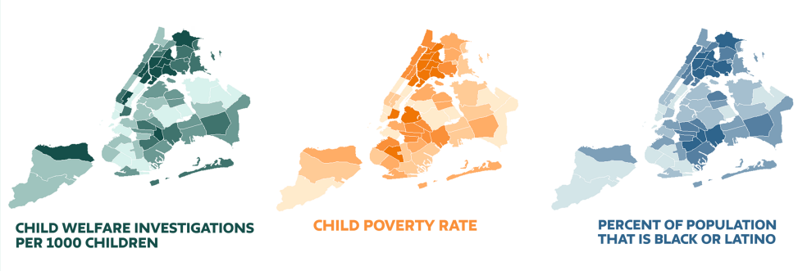
2019 Info from Center for New York City Affairs

Slide 6
Racial Disparity in NYC
Black Families
7.4x more likely to be reported to the SCR than white families
8.9x more likely to have an indicated case than white families
12.6x more likely to have a child in foster care than white families
Latinx Families
5.9x more likely to be reported to the SCR than white families
7.1x more likely to have an indicated case than white families
5.8x more likely to have a child in foster care than white families
OCFS 2022

Slide 7
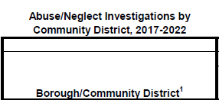
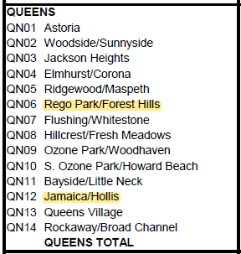
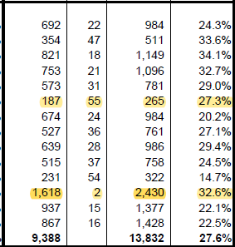
District 28 and ACS

Slide 8
CFR: What We Do
Primary provider of indigent defense for parents in neglect/abuse cases in Manhattan and Queens and a secondary provider in the Bronx for both respondent and non-respondent parents.
Youth Defense (children 7-17 years of age)
State Central Register representation
Early Defense
Wrap-around legal representation
Immigration
Criminal
Civil/Housing

Slide 9
Contact Us
Contact us if you need representation
Contact us if you know of any group of parents or youth that might benefit from a longer presentation
Resources and information can be found online at:
yourfamilyyourrights.org

Slide 10
Contact us
Center for Family Representation, Inc.
89-14 Parsons Blvd, Floor 2
Jamaica, NY 11432
Phone: 212-691-0950
Email: info@cfrny.org
Early Defense/ACS investigations (parents/caregivers)
investigationhelp@cfrny.org
SCR Advocacy
SCRhelp@cfrny.org
Youth Defense (7-17 years old)
YouthDefense@cfrny.org

Slide 11
THANK YOU

